Slide 1
WORKOOPOLIS
Overview of DevOps

Slide 2
Overview of DevOps
Why DevOps
What is DevOps
DevOps Market Trends
DevOps Engineer Skills
DevOps Delivery Pipeline
DevOps Ecosystem

Slide 3
Why DevOps
Non functional requirement.
Shorter Development Cycles, Faster Innovation
Reduce Implementation Failure, Reflections and Recovery Time
Better Communication and Cooperation
Configuration Management.
Reduce Costs and IT Staff
Apps stability
Create or enhance services
Backups
Upgradability.

Slide 4
What is DevOps
Devops is an approach to bridge the gap between agile software development and operation.
It is a combination of software development and operation.
Devops help organization to deploy application more frequently, while maintaining service stability and gaining the speed for necessary for more innovation.
Devops is a methodology.
Devops is a set of principle and practices.
SRE

Slide 5
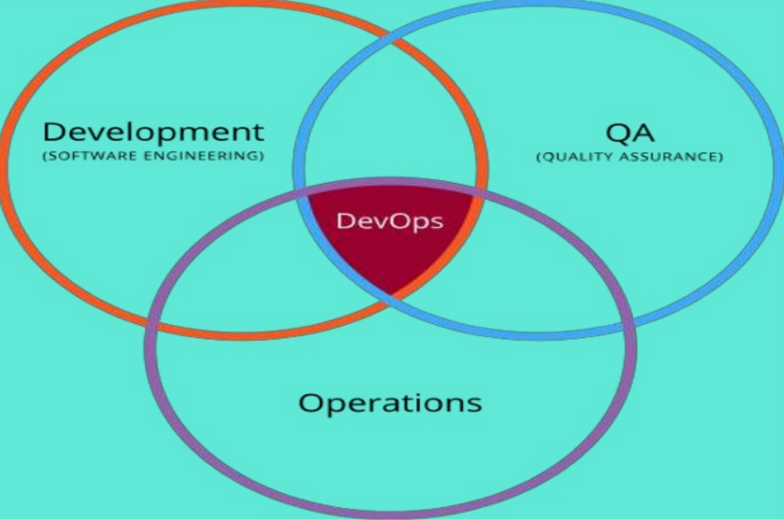
DevOps Overview

Slide 6
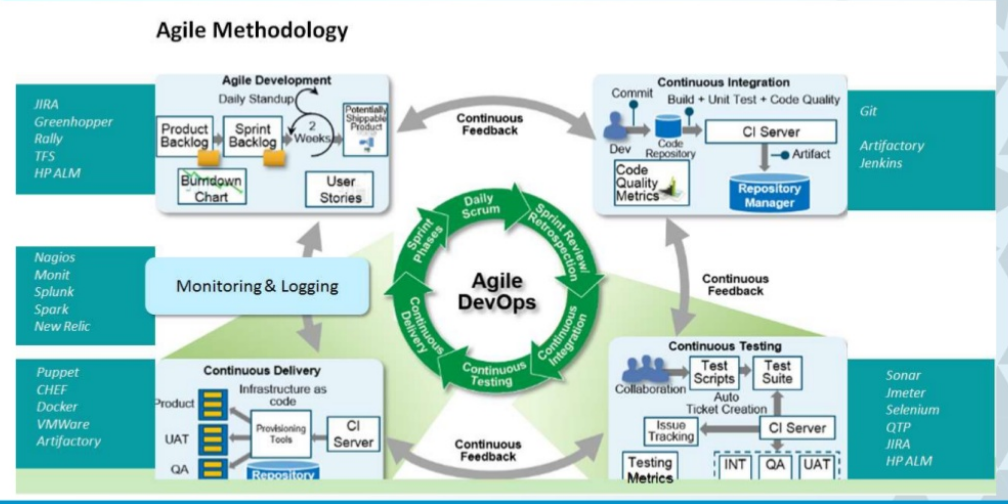
DevOps A Representative Reference Architecture

Slide 7
DevOps Market Trends
Automation Will Become the Primary Focus
Increase in the Adoption of Microservices Architecture
More Companies Are Expected to Opt for Enterprise Versions
Kubernetes Is Going to Evolve Significantly
Security Will Become the Primary Focus — DevSecOps
AI & ML Will Foster DevOps Growth

Slide 8
DevOps Engineer Skills
Flexibility.
Security Skills.
Collaboration.
Scripting Skills.
Decision-making.
Infrastructure Knowledge.
Soft Skills.

Slide 9
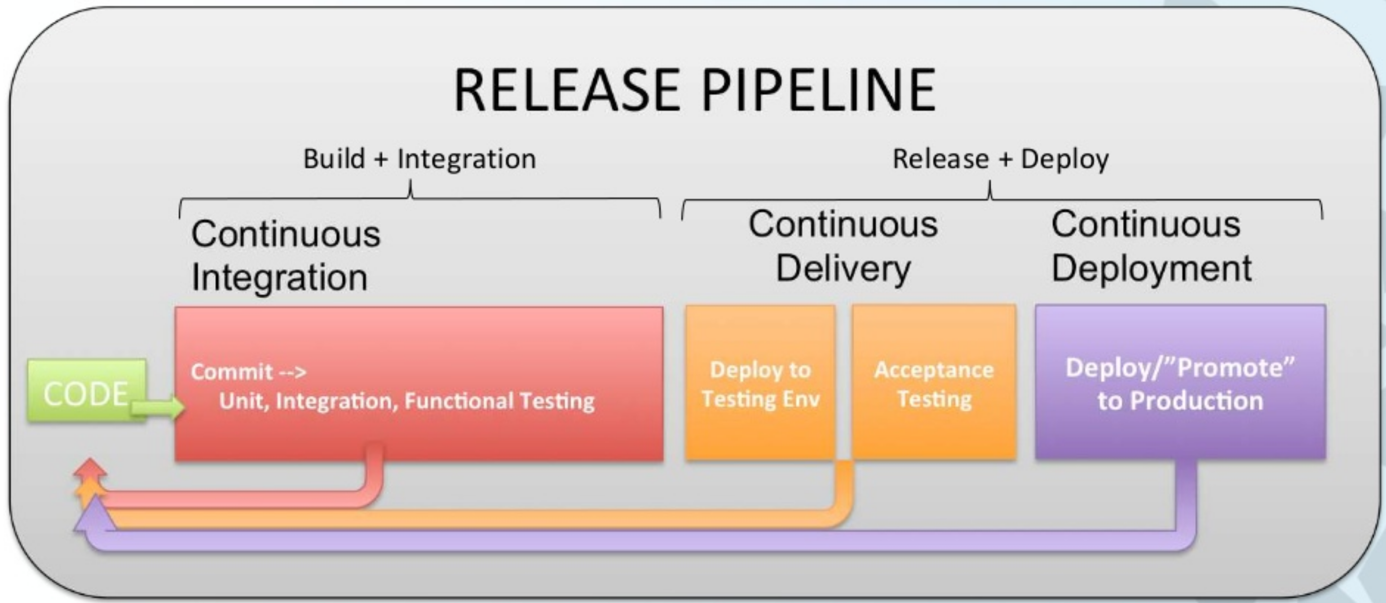
DevOps Delivery Pipeline

Slide 10
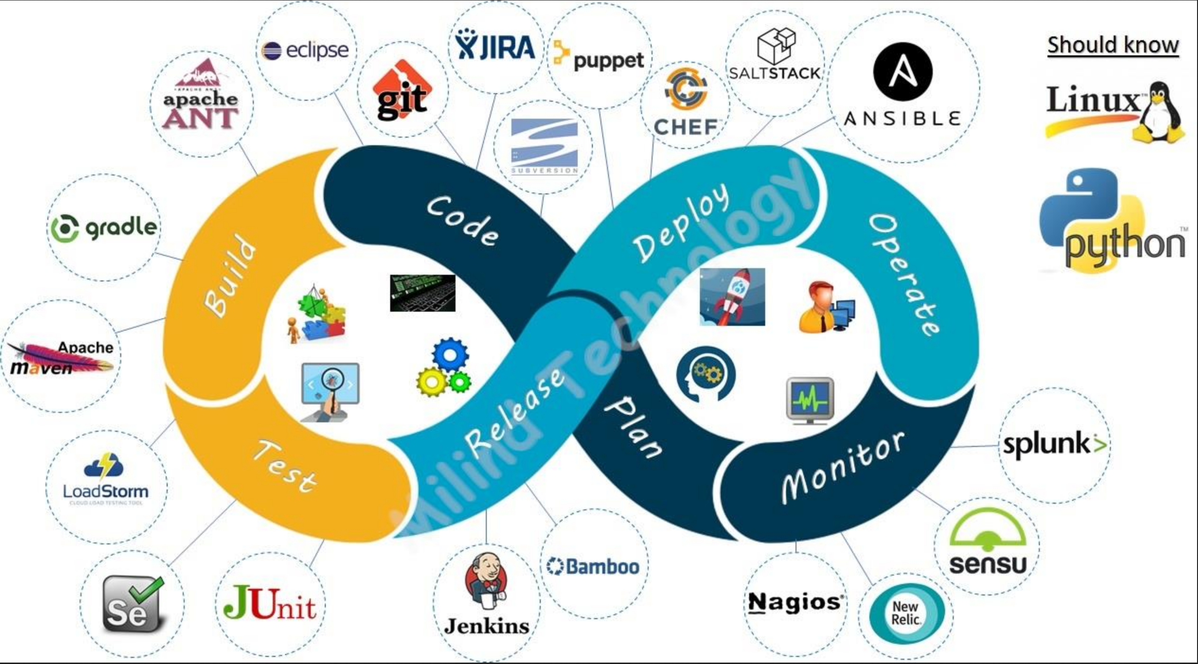
DevOps Ecosystem

Slide 11
Assignment
List down the list for tools/software for different devops life cycle.

